Slide 1
Tie-set Based Fault Tolerance (TBFT)
Kiyoshi Nakayama, Kyle Benson,
Yi-Hsi Huang, Vahe Avagyan, Lubomir Bic,
Michael Dillencourt
Comp. Science, University of California, Irvine, USA
Notes:
From now, I am going talk about my research titled “Tie-set …”.
My name is Kiyoshi Nakayama from Graduate School of Engineering, Soka University.

Slide 2
Research Target
Background
Networks are becoming Large-Scale, Complicated
(Mesh Topology, Intricately-Intertwined)
Loop (Ring) Network Management
Ring Protection of Failure Recovery
Loop Management in Power Grid
Aiming at Versatile Autonomous Distributed Local Control
for Various Network Problems based on Loop Structure

Slide 3
Existing Protocols Focusing on Rings

Slide 4
Existing Protocols Applicable to Mesh Networks

Slide 5
Route Switching based on Tie-Sets

Slide 6
Our Research Target

Slide 7
Tie-Set Graph Theory

Slide 8
Distributed Control based on Tie-Sets
What is the Tie-Set?
・ A Set of Links (Edges) that constitutes a LOOP. (Cycle or Ring).
Ex: Tie-set L1={e1, e2, e3}
b
d
a
f
Fundamental System of Tie-sets
・ Tie-Sets (Loop Structure) Defined by a TREE
Ex: {L1, L2 , L3, L4}
c
e
Fundamental System of Tie-sets
Advantages
Cover an ENTIRE Network with LOOPS !
・ Communications become easy as Messages are exchanged within a Tie-Set
・ Independent Solution by Autonomous Distributed Control in a Tie-Set even in a Mesh Network
Notes:
そこで本研究では、これらの問題解決に向けてタイセットに基づいた分散制御の開発に取り組んでいます。

Slide 9
Various Tie-Sets by Trees
Segmentation
using tie-set theory
n1
n3
L１
L2
L4
Tie-set distribution is different
by formulation of tree
n0
n5
L3
n2
n4
Creation of Optimal Tree should be considered
n1
n3
n1
n3
L2
L4
L１
L2
L4
n0
L1
n5
n0
n5
L3
L3
n2
n4
n2
n4

Slide 10
State Information of a Node
Each node has Tie-set Information to which the node belong

Slide 11
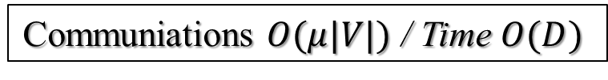
DATIC
DATIC: Distributed Algorithm for Tie-set Information Configuration
e4,e3
n3,n1
e4
n3
n1
n3
FTM: Find Tie-set Message
Message to find Tie-set Information
L１
L2
L4
n0
n5
L3
Only nodes connected to Co-Tree conduct DATIC.
Two nodes connected a cotree link negotiate (let ni do DATIC).
ni sends FTM to nj on cotree with info of ni and e(ni, nj).
FTM is copied and sent out on T.
FTM comes back to ni.
ni sends FTM on a tie-set to notify its info.
e4,e3,e5
n3,n1,n2
e4,e3,e6
n3,n1,n2
e4,e3,e2
n3,n1,n2
n2
n4
Ex. Tie-set L2 whose Co-Tree is e4
n1 and n3 connected e4 negotiate.
n3 conducts DATIC
Other Tie-set Info are constructed
in the same way simultaneously
Communiations $O(μ|V|)$ / Time $O(D)$

Slide 12
Single Link Failure Recovery

Slide 13
Distributed Control for Link Failure
Procedure in a Node
Tie-Set Information of n3
Blocking physical ports connected to ef
Send ”ClosePort” Message to n2
Finding a tie-set Li from Tie-set Information, where ef ∊ Li
L2 and L3 are chosen
n3 detect the failure
Determining a tie-set Lr to conduct route switching
e4
n1
n3
e1
e8
L１
L2
ComRoute is shifted in L2 (ef →e4)
n0
e3
ef
e7
L4
n5
e5
Opening physical ports connected to the cotree link
L3
e9
e2
n2
e6
n4
Send ”OpenPort” Message to n1

Slide 14
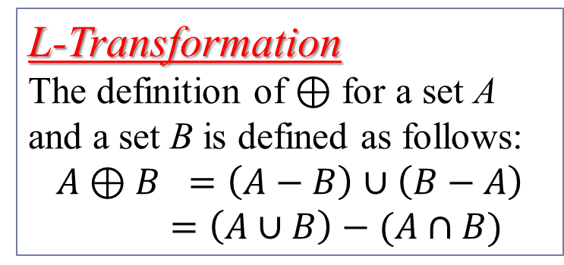
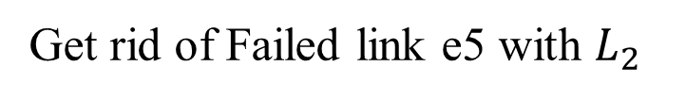
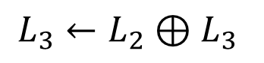
Procedures after Failure
L-Transformation
The definition of $⊕$ for a set A and a set B is defined as follows:
$$A⊕B =\left(A−B\right)∪\left(B−A\right)=\left(A∪B\right)−(A∩B)$$
Tie-Set Info at n3
Procedure in a Node
e4
n1
n3
Apply L-Transformation
e1
e8
L１
L2
n0
n5
$$L_{3}←L_{2}⊕L_{3}$$
e3
L3
e7
L4
e5
L3
Get rid of Failed link e5 with $L_{2}$
e2
e9
n2
e6
n4

Slide 15
Double-Link Failure Recovery

Slide 16
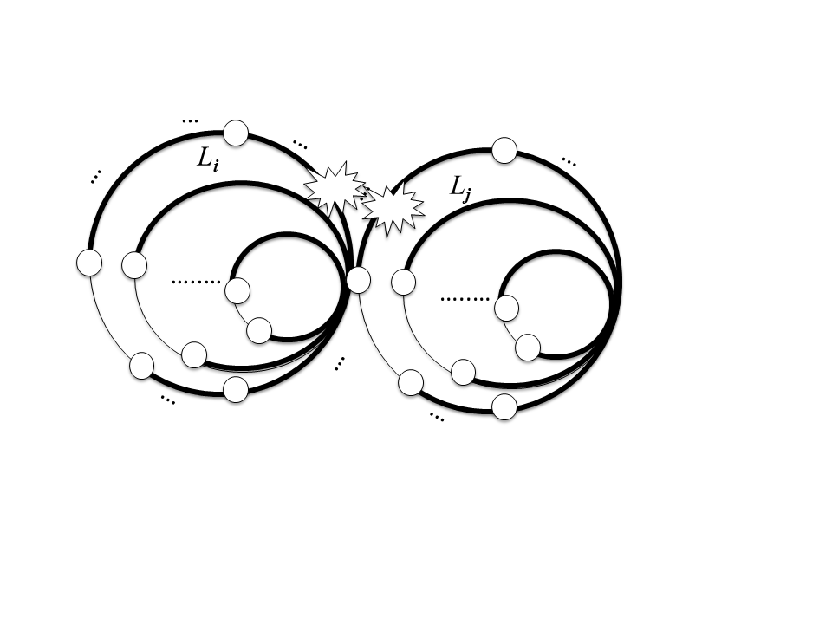
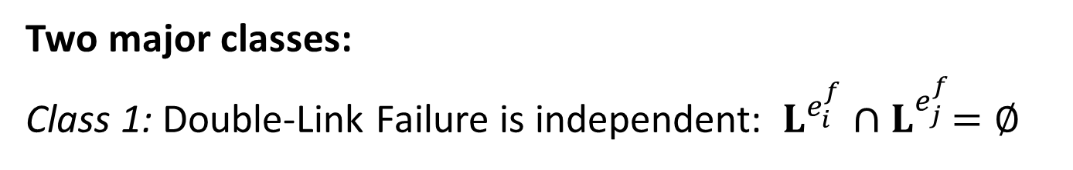
Classification of Double-Link Failure
Two major classes:
Class 1: Double-Link Failure is independent: $L^{e_{i}^{f}}{∩L}^{e_{j}^{f}}=∅$
Essentially the same problem with Single link failure.
The double-link failure is handled by different tie-sets Li and Lj individually and autonomously.
Class 2: Double-Link Failure is Dependent : $L^{e_{i}^{f}}{∩L}^{e_{j}^{f}}≠∅$

Slide 17
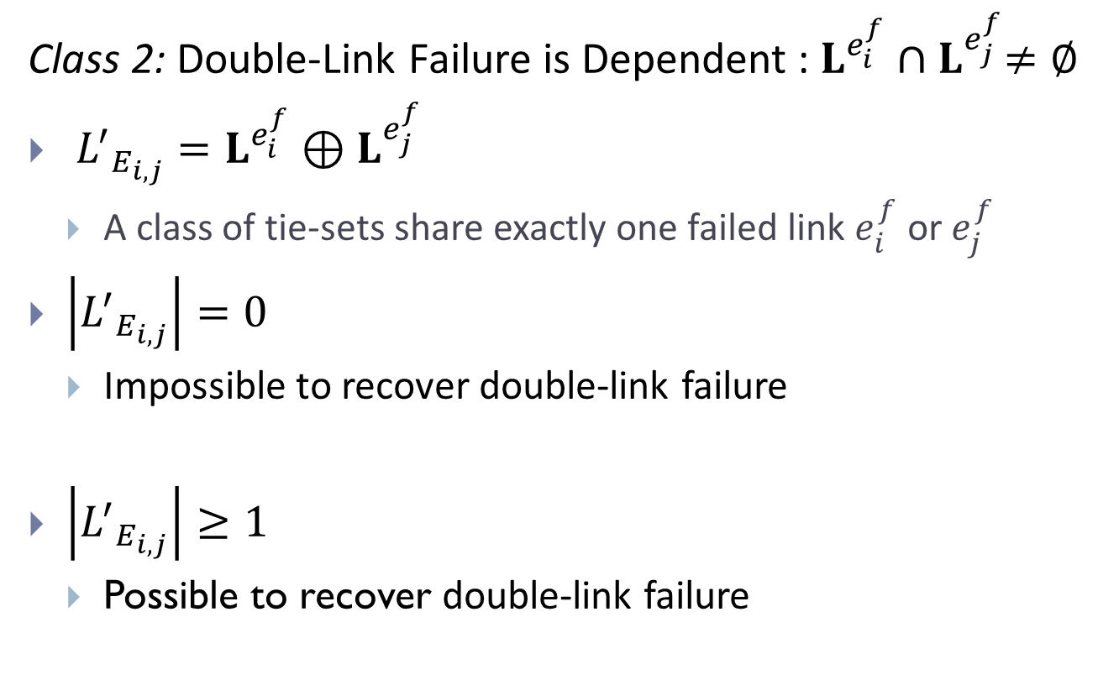
Classification of Double-Link Failure
Class 2: Double-Link Failure is Dependent : $L^{e_{i}^{f}}{∩L}^{e_{j}^{f}}≠∅$
${L^{′}}_{E_{i,j}}=L^{e_{i}^{f}}{⊕L}^{e_{j}^{f}}$
A class of tie-sets share exactly one failed link $e_{i}^{f}$ or $e_{j}^{f}$
$\left|{L^{′}}_{E_{i,j}}\right|=0$
Impossible to recover double-link failure
$\left|{L^{′}}_{E_{i,j}}\right|≥1$
Possible to recover double-link failure

Slide 18
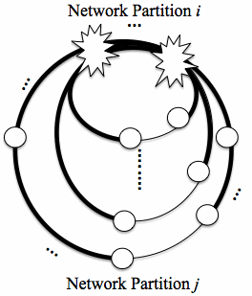
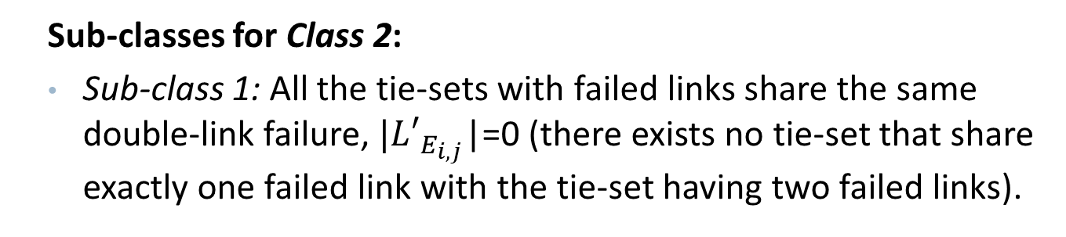
Class 2
Sub-classes for Class 2:
Sub-class 1: All the tie-sets with failed links share the same double-link failure, $|{L′}_{E_{i,j}}$|=0 (there exists no tie-set that share exactly one failed link with the tie-set having two failed links).
The system is divided into two network partitions. There is no way to redirect the messages between separate network partitions.
Such a distributed system can not be restored with either RSTP or TBFT.

Slide 19
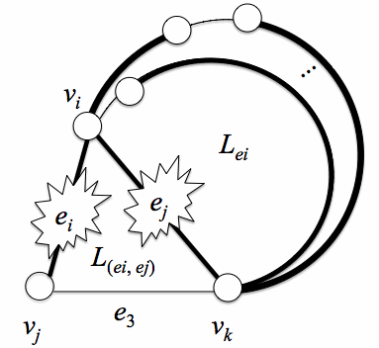
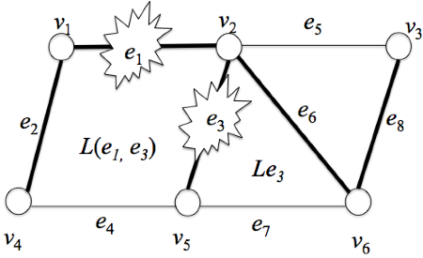
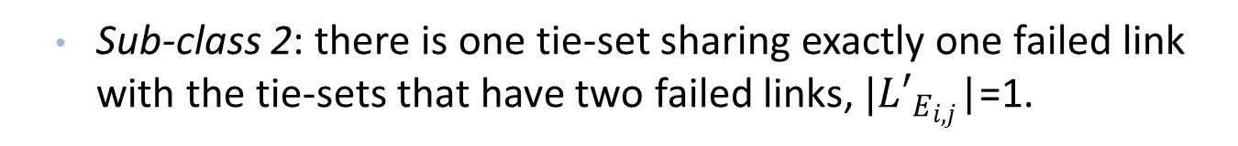
Class 2
Sub-class 2: there is one tie-set sharing exactly one failed link with the tie-sets that have two failed links, $|{L′}_{E_{i,j}}$|=1.
The tie-set with only one failed link should be responsible to recover its failed link.

Slide 20
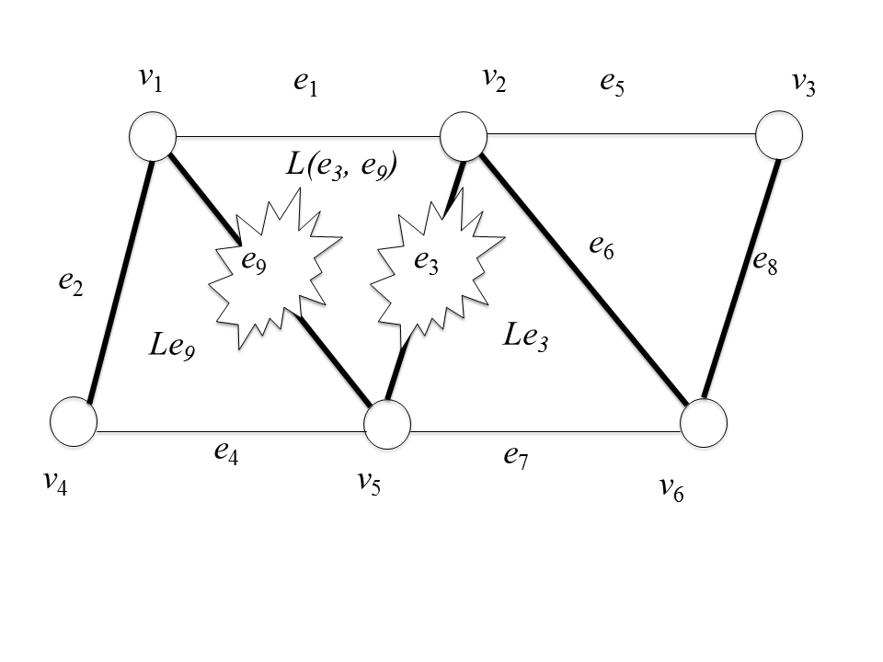
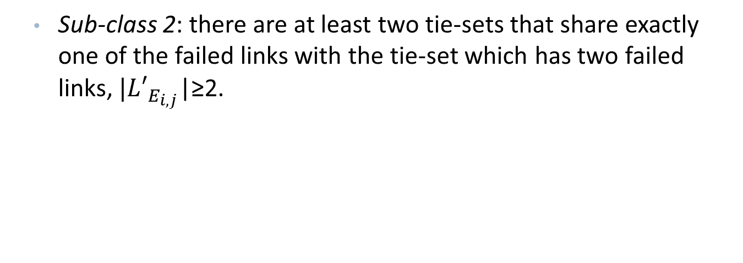
Class 2
Sub-class 2: there are at least two tie-sets that share exactly one of the failed links with the tie-set which has two failed links, $|{L′}_{E_{i,j}}$|≥2.
Tie-sets with only one failed link should be responsible to recover the failed link they have.

Slide 21
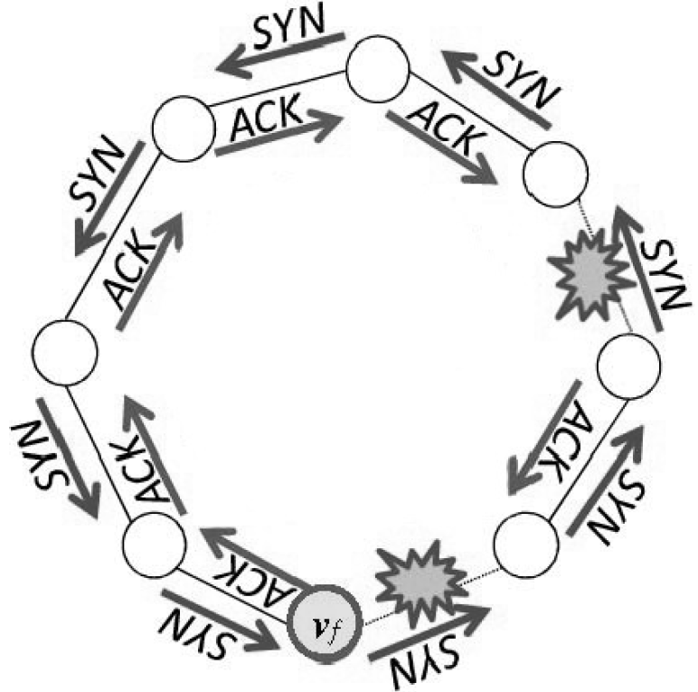
Failure detection mechanism.
Each node vi sends SYN message to an adjacent node va (periodically within some time period tsyn).
Each node vi receives ACK response message from va (during a time period tack).
The direction may be decided by the order of edges in Tie-set Information table, such as EdgeTable or NodeTable.

Slide 22
Failure recovery algorithm.
Algorithm for vf that detects failure on ef :
Step 1: Blocking physical ports connected to ef.
Step 2: Selecting from Tie-set Information a set of tie-sets that include ef.
Step 3: Sharing information about the failure ef within nodes of selected set of tie-sets.
Algorithm for vi :
Step 4: Receiving a message about failure and storing the failure information, sending a copy of the message to the next node in the tie-set.
Step 5: Analyzing failure information and making a decision.
Step 6: Opening physical ports connected to the cotree link.

Slide 23
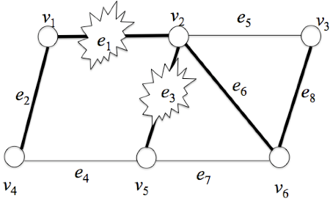
Failure recovery algorithm.
Step 1: Blocking physical ports connected to ef.
L₂
v1 and v2 block their ports to e1.
v2 and v5 block their ports to e3.
L₁
L₃

Slide 24
Failure recovery algorithm.
Step 2: Selecting from Tie-set Information a set of tie-sets that include ef.
Tie-Set Information of v2
L={L₁, L₂, L₃}
L₂
L₁ ={e₁, e₂, e₃, e₄ }
L₁
L₂ ={e₅, e₆, e₈}
L₃
L₃ ={e₃, e₆, e₇}
e₁ ϵ L_{e1} ={L₁}
e₃ ϵ L_{e3}={L₁, L₃}

Slide 25
Failure recovery algorithm.
Step 3: Sharing information about the failure ef within nodes of selected set of tie-sets.
Failure on e₃ ϵ L₁,L₃
L₂
v2
v6
L₁
L₃

Slide 26
Failure recovery algorithm.
Step 4: Receiving a message about failure and storing the failure information, sending a copy of the message to the next node in the tie-set.
Failure information on v6
e₃ ϵ L₁,L₃
L₂
L₁
L₃
Failure on e₁ ϵ L₁
v4
v5
Failure information on v5
e₁ ϵ L₁
e₃ ϵ L₁,L₃

Slide 27
Failure recovery algorithm.
Step 5: Analyzing failure information and making a decision.
Analysis on v₆:
Connected to cotree e₇
{e₃ } ϵ L₃
=> recover e₃
L₂
Analysis on v₅:
Connected to cotree e₄,e₇
{e₁ , e₃} ϵ L₁
{e₃ } ϵ L₃
L₁
L₃
=> recover e₁
Step 6: Opening physical ports connected to the cotree link.

Slide 28
Evaluation & Comparison with RSTP
Evaluation
Theoretical Analysis with Distributed Algorithms
・ Communication Complexity and Time Complexity
Experiments
The Number of Route Switched Points
・ Throughput
・ Delay in Failure Recovery
The Number of Hops (from Node that detects a link failure to Node that completes the restoration)
・ Estimation of Recovery Time
The Number of Influenced Nodes (that change the Communications Port States )
・ Communications Reliability and Quality
Superior than RSTP in terms above

Slide 29
Simulation and Experiments against RSTP

Slide 30
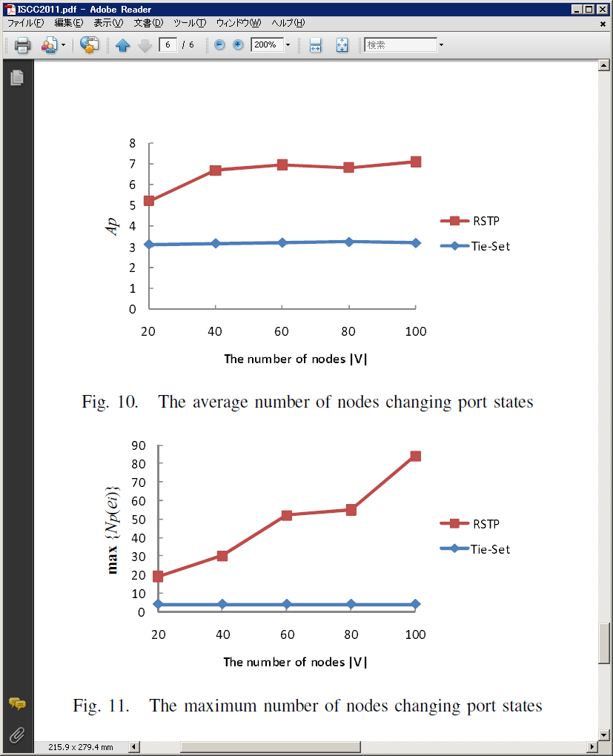
Experiments against RSTP

Slide 31
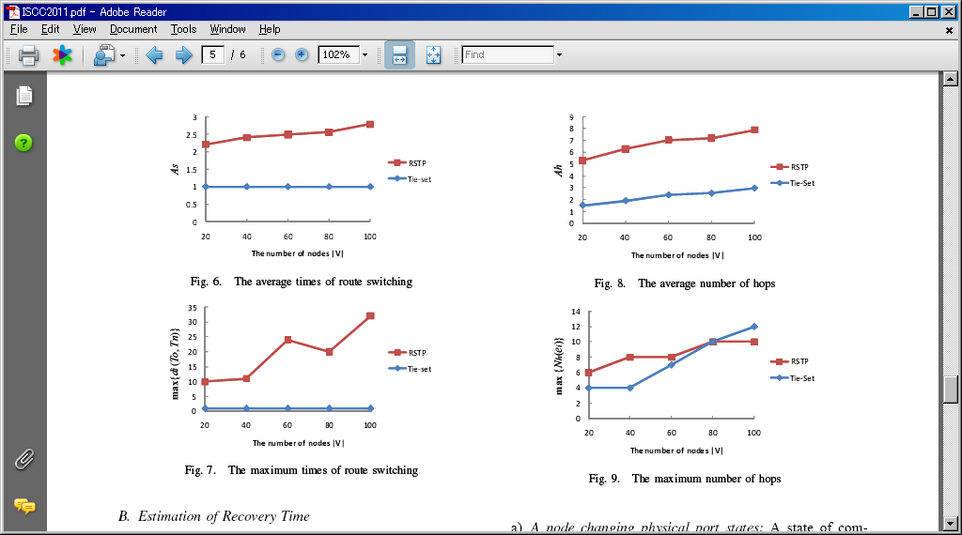
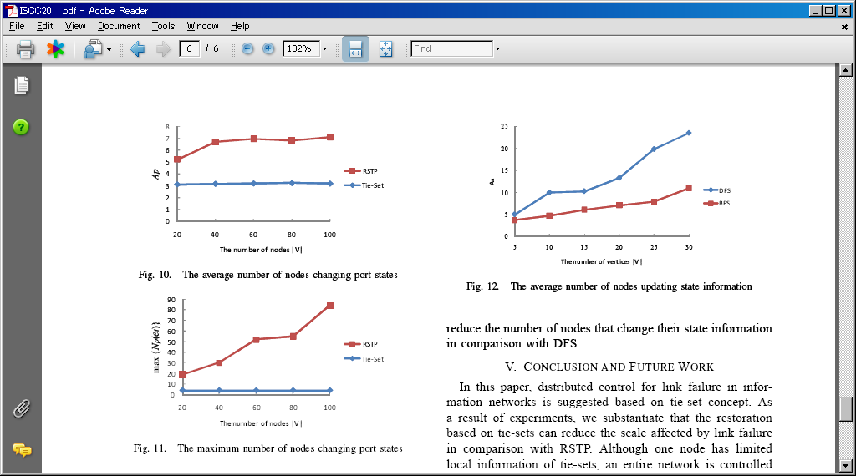
Experiments on Hops and State Information

Slide 32
Simulation results.

Slide 33
Conclusion and Future Works

Slide 34
Thank you for your kind attention!

Slide 35
Distributed Control for Link Failure

Slide 36
Behavior of Route Switching

Slide 37
After Route Switching in a Tie-Set

Slide 39
Analysis of Algorithms

